Slide 1

DETECTION AND CLASSIFICATION OF FRUIT DISEASES
Team members guide
Z.L.Sunarvitha(177R1A0556) DR.A.Prabhu
B.Nikhitha(177R1A05C7)
H.Ajay Reddy(177R1A0527)
CH.Mohan Krishna(167R1A0523)

Slide 2
Abstract
Fruit disease detection is vital at early stage since it will affect the agricultural field. In this project, mainly consider the detection and analysis of fruit infections which is available in the plant areas and storage of data about the agricultural filed and details of farmers in database and recovering the data using Cloud computing. There are more fruit diseases which occur due to the surrounding conditions, mineral levels, insects in the farm area and other factors. The detected data from the plant area is determined by image processing and stored in the database.

Slide 3
Existing System:
A K-means segmentation is used for partitioning the leaf
image into four clusters using the squared Euclidean
distances. The method applied for feature extraction is
Colour Co-occurrence method for both colour and
texture features. Finally, classification is completed using
neural network detection algorithm based on back
propagation methodology

Slide 4
Disadvantages
Accuracy is less

Slide 5
Proposed System:
The classification and segmentation of fruit images were
performed using K-Means Algorithm and SVM technique.
The various features of few fruits were initially extracted and segment the respective images.
After comparison with feature values, the various disease names are analyzed and the optimal disease for the image is identified and the disease is indicated by an alert box and can be provided as the message through mobile application.

Slide 6
Advantages
Agriculture is becoming digital, AI in agriculture is emerging in three major categories which are agricultural robotics, soil & crop monitoring, and predictive analytics,.

Slide 7
Hardware requirement
Processor: I3/Intel
RAM: 4GB
Hard Disk: 128 GB

Slide 8
Software requirements 
Operating System: Windows 10
Server-side Script: Python 3.7
IDE: PyCharm
Libraries Used: Pandas, Numpy,Flask
Google colab

Slide 9
MODULES
Upload Data
Predict Result

Slide 10
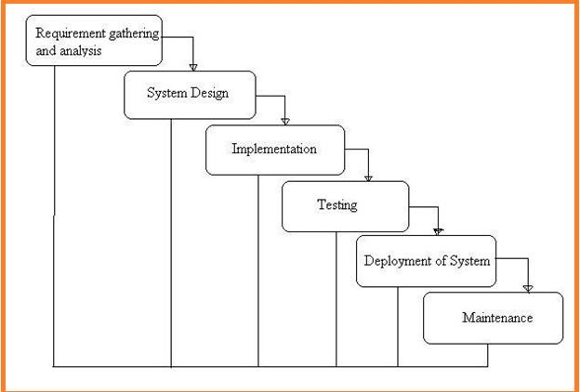
System Architecture

Slide 11
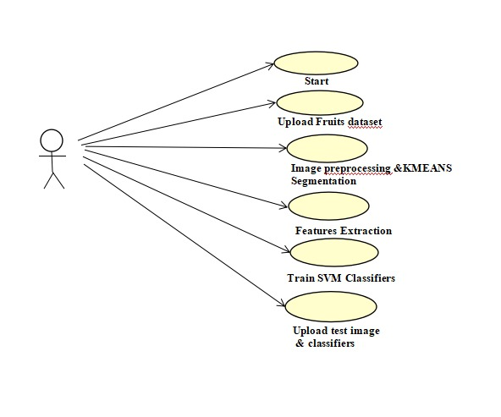
Use case diagram

Slide 12
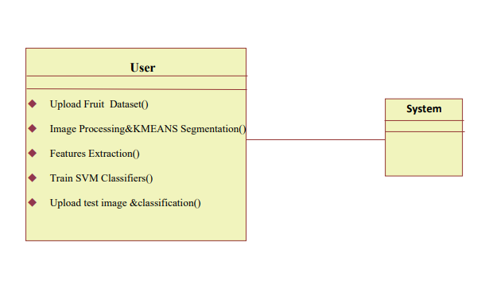
Class Diagram

Slide 13
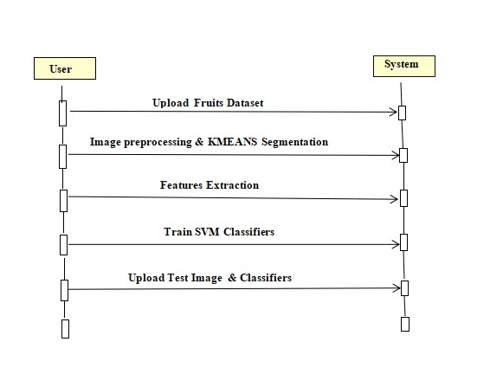
SEQUENCE DIAGRAM

Slide 14
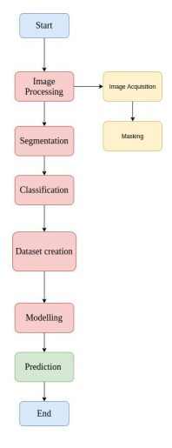
Flow chart

Slide 15
Sample ode
def upload():
global filename
filename = edialog.askopenfilename(initialdir = ataset")
pathlabel.config(text = filename)
text.delete('1.0', END)
text.insert(END,filename+" loaded\n");
def generateModel():
global X_train, X_test, y_train, y_test
text.delete('1.0', END)
train = pd.read_csv(filename)
rows = train.shape[0]
cols = train.shape[1]
features = cols-1
print(features)
X = train.values[:,0:features]
Y = train.values[:,features]
print(Y)
X_train, X_test,y_train,y_test = train_test_split(X,Y, test_size = 0.2, random_state = 0)
text.insert(END,"Dataset Length :"+str(len(X))+"\n");
text.insert(END,"Splitted Training Length : "+str(len(X_train))+"\n");
text.insert(END,"Splitted Test Length : "+str(len(X_test))+"\n\n");
def prediction(X_test, cls): #prediction done here
y_pred = cls.predict(X_test)
for i in range(len(X_test)):
print("X=%s, Predicted=%s" % (X_test[i], y_pred[i]))
return y_pred
# Function to calculate accuracy
def cal_accuracy(y_test, y_pred, details):
cm = confusion_matrix(y_test, y_pred)
accuracy = accuracy_score(y_test,y_pred)*100
text.insert(END,details+"\n\n")
text.insert(END,"Accuracy : "+str(accuracy)+"\n\n")
text.insert(END,"Report : "+str(classification_report(y_test, y_pred))+"\n")
text.insert(END,"Confusion Matrix : "+str(cm)+"\n\n\n\n\n")
return accuracy

Slide 16
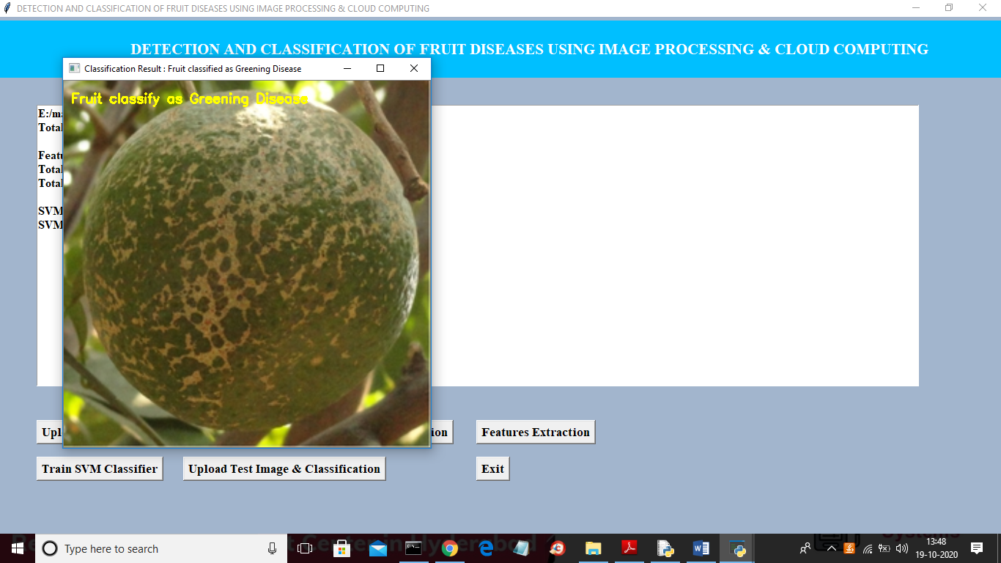
Results

Slide 17
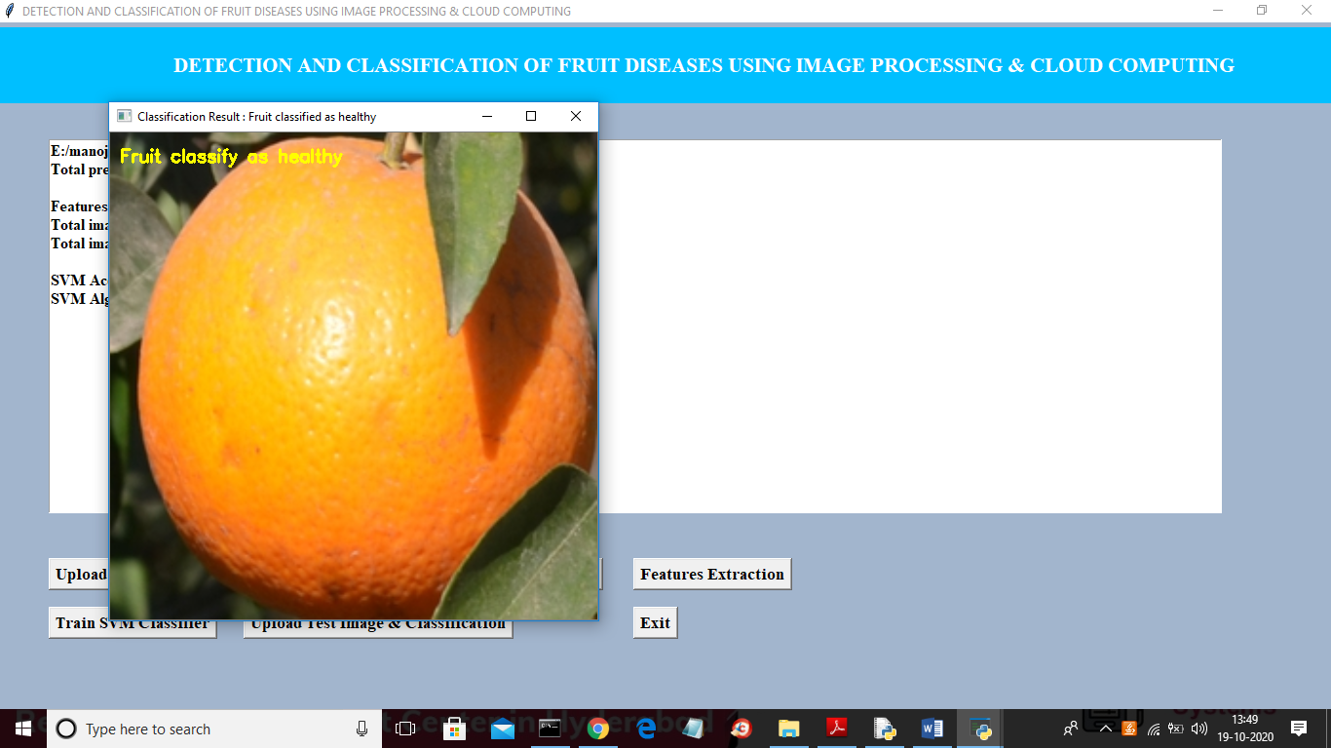

Slide 18
Conclusion
The development of cloud based scheme for helping Indian farmers and agriculture, helps to analyze the agriculture data in a better way to reduce the hoardings and in bringing up a prosperous safe and peaceful farmer society in India. The classification and segmentation of fruit images were performed using K-Means Algorithm and SVM technique. The various features of few fruits were initially extracted and segment the respective images. After comparison with feature values, the various disease names are analyzed and the optimal disease for the image is identified and the disease is indicated by an alert box and can be provided as the message through mobile application. The total number of samples provided, the true and false positions, the true and false negativities, the accuracy and the specificity are also indicated in an alert box.

Slide 19
Future scope
In enhancement we will add some ML Algorithms to increase accuracy

Slide 20
THANK YOU

